Slide 1
Request Baskets
Supervised By - Touhid Alam
IT Manager at Surbana Jurong.
By – MD.Yunus Ali Roni
Software Engineer at Surbana Jurong.

Slide 2
Context
Introduction
Features of Request Basket
Configure HTTTP Response.
Implementation of Request Basket using CURL
Implementation of Request Basket with ReqBin online curl command
References

Slide 3
Introduction:
Request Baskets is a web service to collect arbitrary HTTP requests and inspect them via RESTful API or simple web UI.
Sometimes Web UI is prepared before Backend Api. That time we need some Demo data for the UI from the request basket api.
It is strongly inspired by ideas and application design of the RequestHub project and reproduces functionality offered by RequestBin service.
Request Baskets service is available on our demonstration server: https://rbaskets.in

Slide 4
Features of Request Baskets:
Restful API to manage and configure baskets, see request baskets API documentation in interactive mode.
All baskets are protected by unique tokens from unauthorized access.
Individually configurable capacity for every basket.
Pagination support to retrieve collections: basket names, collected requests.
Configurable responses for every HTTP method.

Slide 5
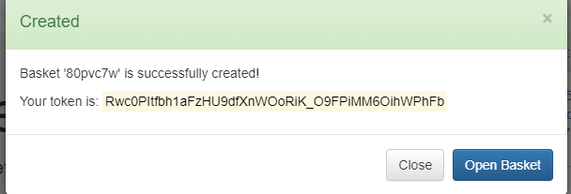
How To Use It?
First of all we have to create a new basket to collect all HTTP Request. Enter this URL to create basket.
https://rbaskets.in/web
After click create button the token will be generated for every new basket and collect it on your notepad. That will be used for fetching the data from this basket.

Slide 6
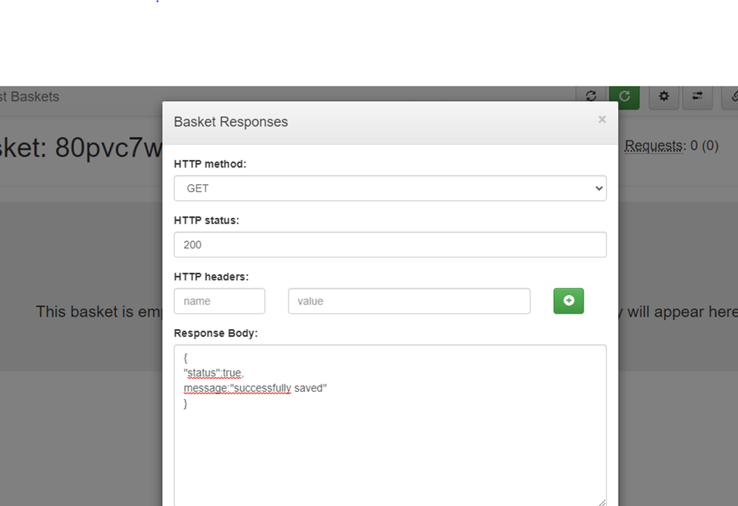
Configurable HTTP response:
We can configure HTTP response for every Http method like POST,GET,Delete,Update.
For this we have to write response body like as JSON object.
Ex. {
“status”:true,
“Message”:”Successfully saved”
}

Slide 7
Implementation of Request Basket using CURL In Linux:
Curl
Curl stands for Client for URLs and it is a command-line tool for Linux, Windows, and macOS for transferring data over the network using HTTP, HTTPS, FTP, and SFTP protocols.
Mainly we can send http request and can test api using cmd.
To store some data in this basket api end point we have to run cmd.

Slide 8
HTTP POST request on basket using Curl:
Command-curl:
syntax:
curl -X POST [URL] -H "Content-Type: [content type]” -d "[JSON data]"
Example:
curl -X POST https://rbaskets.in/p4mcpjs -H 'Content-Type: application/json' -d '{"id":1,"UserName":"Roni"}'
Where:
-X, --request: HTTP method to use when communicating with the server.
-H, --header: HTTP headers to send to the server with a POST request.
-d, --data: Data to be sent to the server using a POST request.

Slide 9
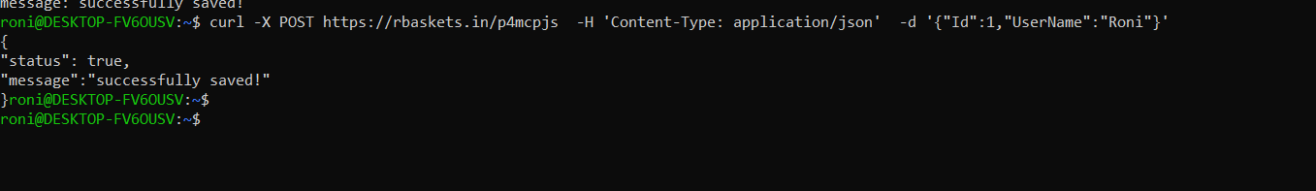
Output:Curl command for HTTP POST
Response from POST Request
POST Request

Slide 10
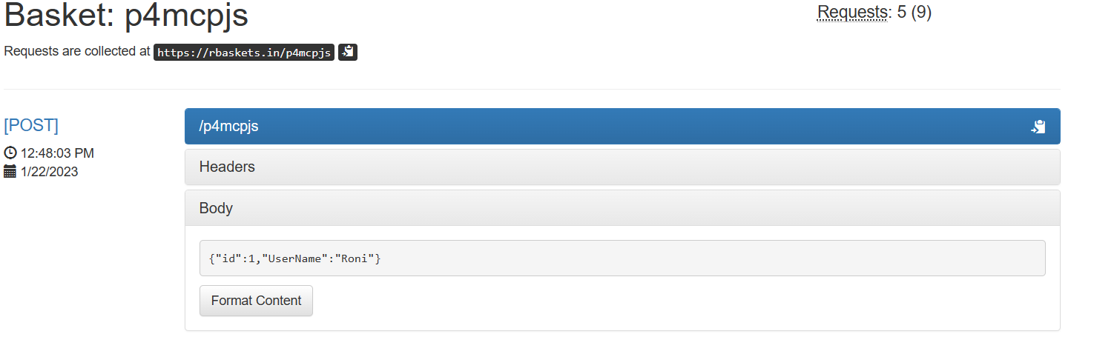
Basket Interface:
After HTTP POST request on basket

Slide 11
HTTP GET request on basket using Curl:
Command-curl:
syntax:
curl [URL] -H "Accept: [content type]“ -H "Authorization: Token“
Example:
curl https://rbaskets.in/api/baskets/p4mcpjs/requests -H "Accept: application/json" -H "Authorization: L1FBMnOHZ4vQy9OlbENcu6AzFHwIk3KkdZ7SZwRgBATH"
Where:
-H, --header: HTTP headers to get the data from the server with a GET request.

Slide 12
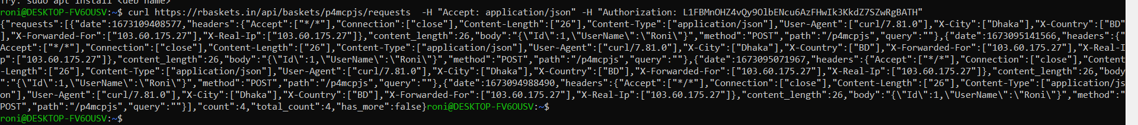
Output: Curl command for HTTP GET
Response from Get Request

Slide 13
Pagination in request basket:
HTTP-GET
Syntax: curl [URL]?max=integarNumber&skip=integarNumber-H " 'Authorization:Token”
-H " Accept: [content type]”
Where:
-max:Maximum number of requests to return; default 20
-skip: Number of requests to skip; default 0
Example:
curl 'https://rbaskets.in/api/baskets/p4mcpjs/requests?max=1&skip=1' -H 'Authorization: L1FBMnOHZ4vQy9OlbENcu6AzFHwIk3KkdZ7SZwRgBATH' -H 'Accept: application/json’
Output:

Slide 14
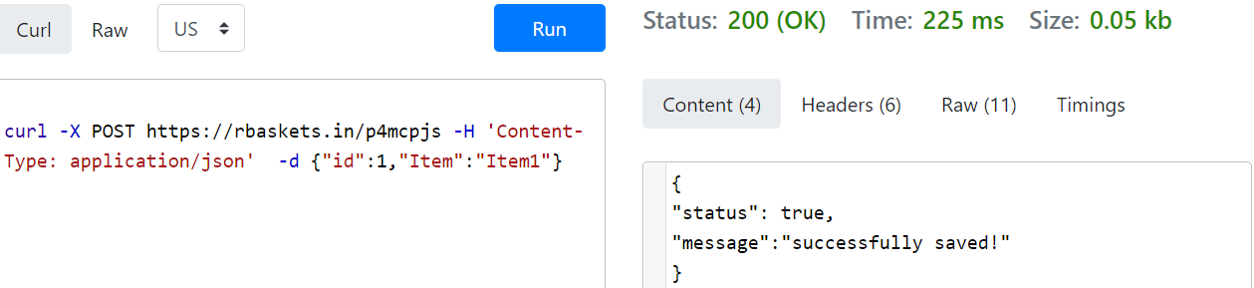
Implementation of Request Basket with ReqBin online curl command:
ReqBin is an online API testing tool for REST Api and Curl command. Test API endpoints by making API requests directly from your browser. Here is the link for Online API Testing Tool : https://reqbin.com/curl
Output: HTTP POST request

Slide 15
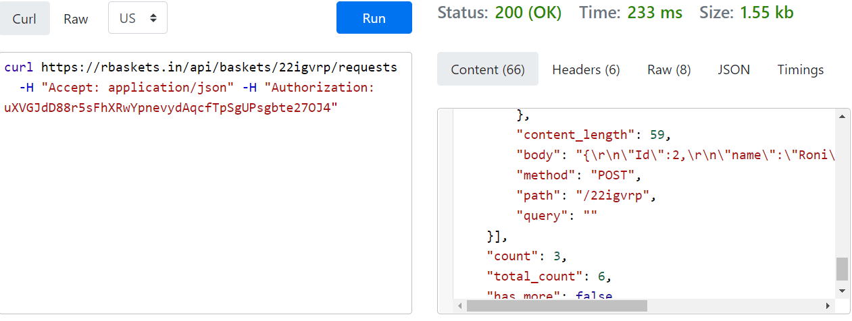
Implementation of Request Basket with ReqBin online curl command:
Output: HTTP GET request

Slide 16
References:
https://rbaskets.in/web
https://reqbin.com/curl
https://github.com/darklynx/request-baskets

